Slide 1




PT Anugrah Terpercaya Kerja
Effective workforce solutions begin with trained, resilient, and reliable people.
anugrahterpercayakerja.co.id

Slide 2
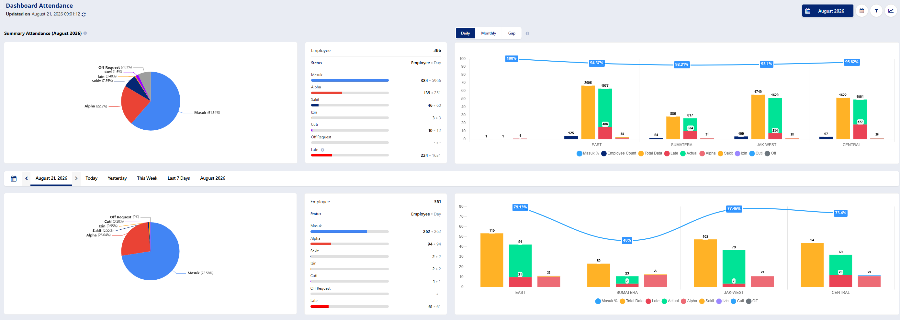
Attendance – Dashboard
PT Anugrah Terpercaya Kerja
Effective workforce solutions begin with trained, resilient, and reliable people.
anugrahterpercayakerja.co.id

Slide 3
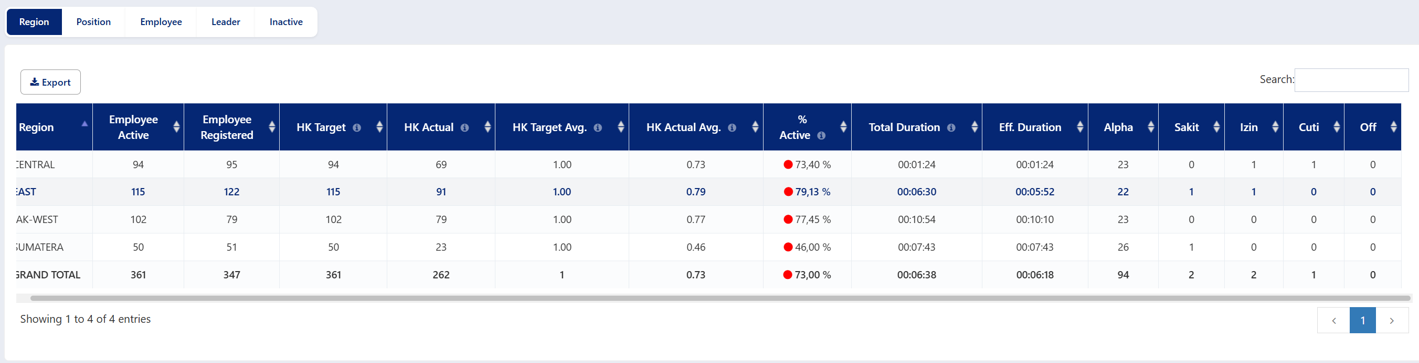
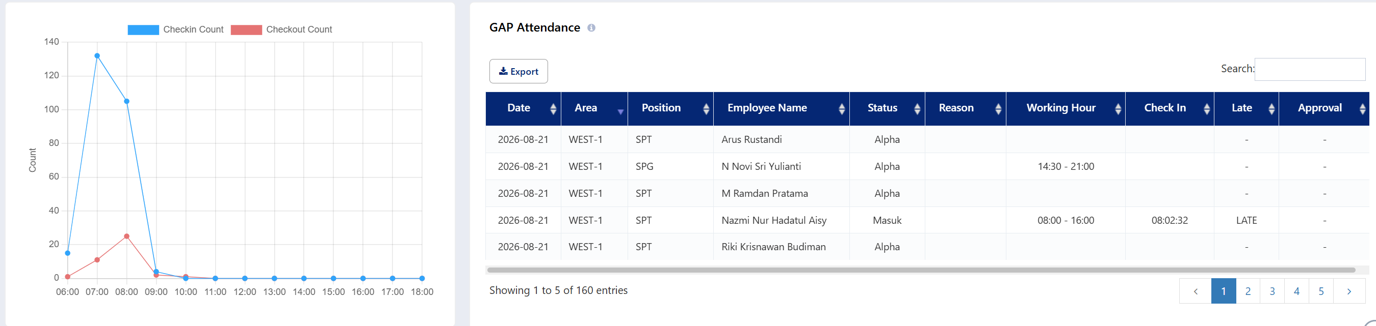
Attendance - Dashboard
PT Anugrah Terpercaya Kerja
Effective workforce solutions begin with trained, resilient, and reliable people.
anugrahterpercayakerja.co.id

Slide 4
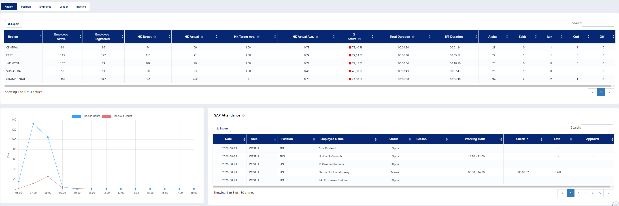
Attendance - Dashboard
PT Anugrah Terpercaya Kerja
Effective workforce solutions begin with trained, resilient, and reliable people.
anugrahterpercayakerja.co.id

Slide 5
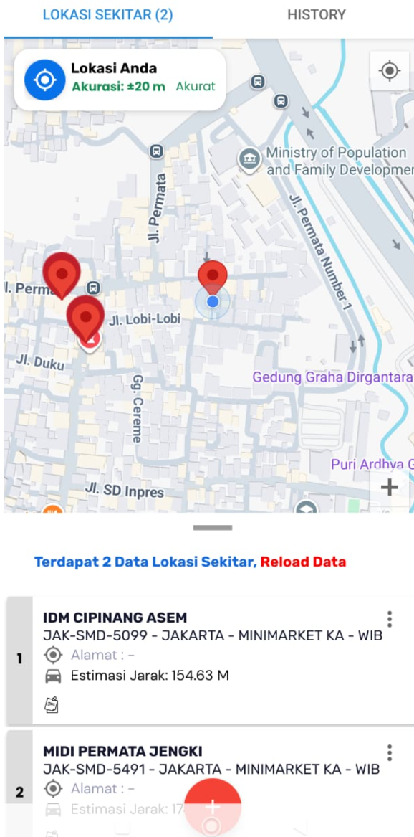
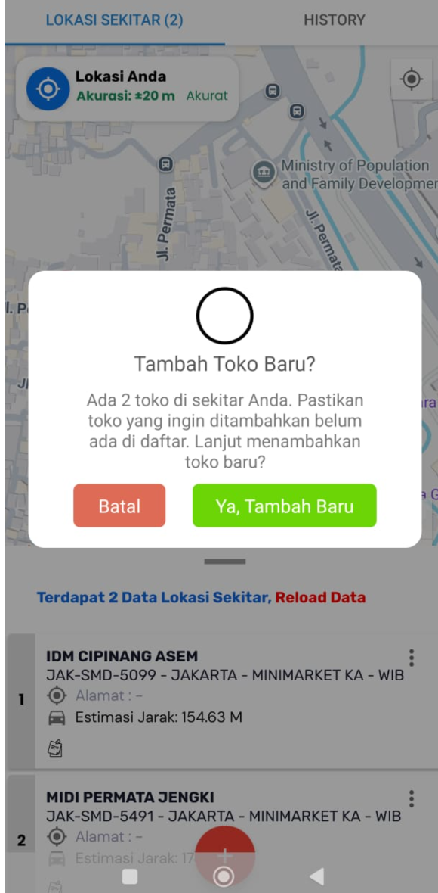
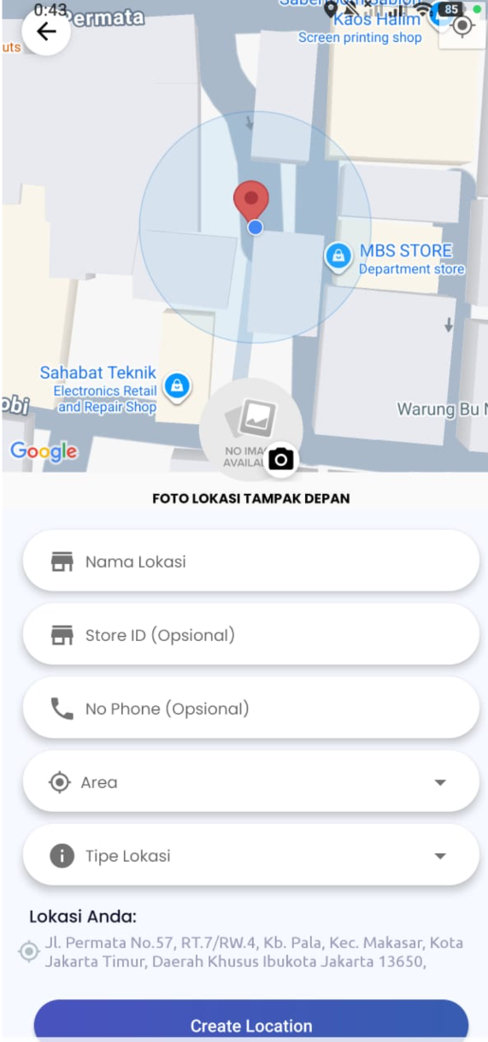
Attendance – Check in
PT Anugrah Terpercaya Kerja
Effective workforce solutions begin with trained, resilient, and reliable people.
anugrahterpercayakerja.co.id

Slide 6
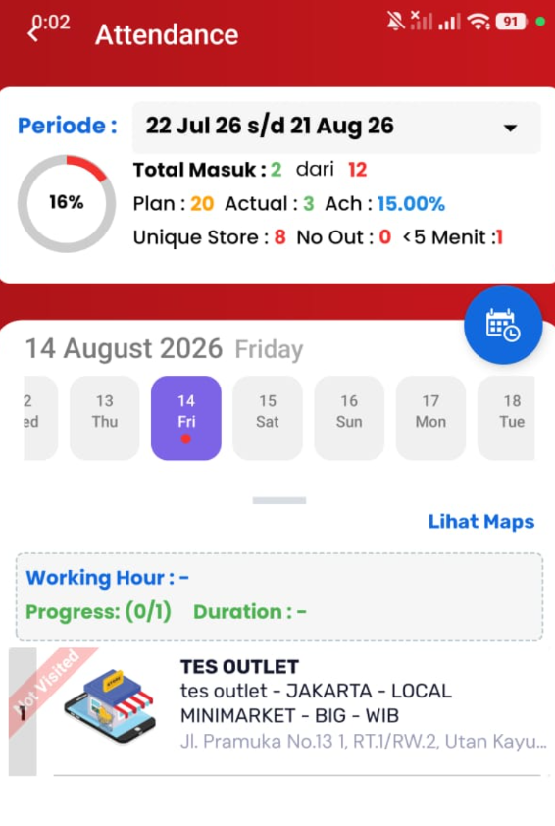
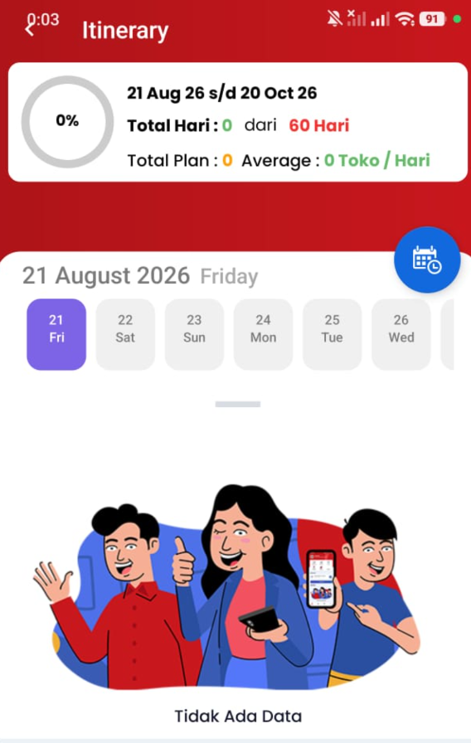
Attendance – Itinerary
PT Anugrah Terpercaya Kerja
Effective workforce solutions begin with trained, resilient, and reliable people.
anugrahterpercayakerja.co.id

Slide 7
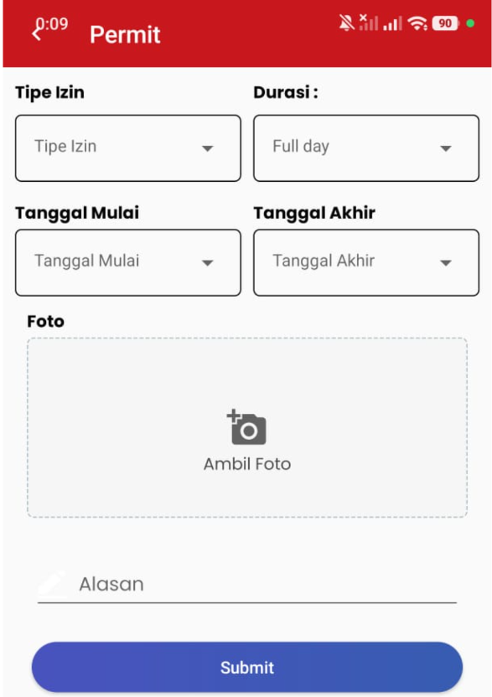
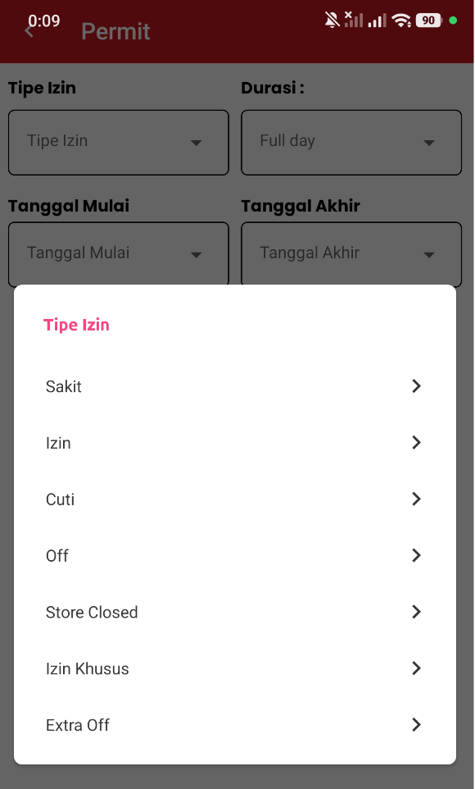
Attendance - Permit
PT Anugrah Terpercaya Kerja
Effective workforce solutions begin with trained, resilient, and reliable people.
anugrahterpercayakerja.co.id

Slide 8
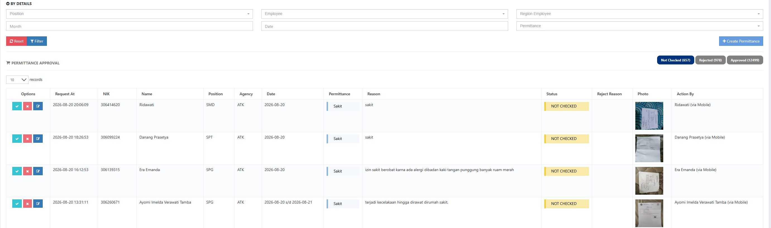
Attendance - Permit
PT Anugrah Terpercaya Kerja
Effective workforce solutions begin with trained, resilient, and reliable people.
anugrahterpercayakerja.co.id

Slide 9
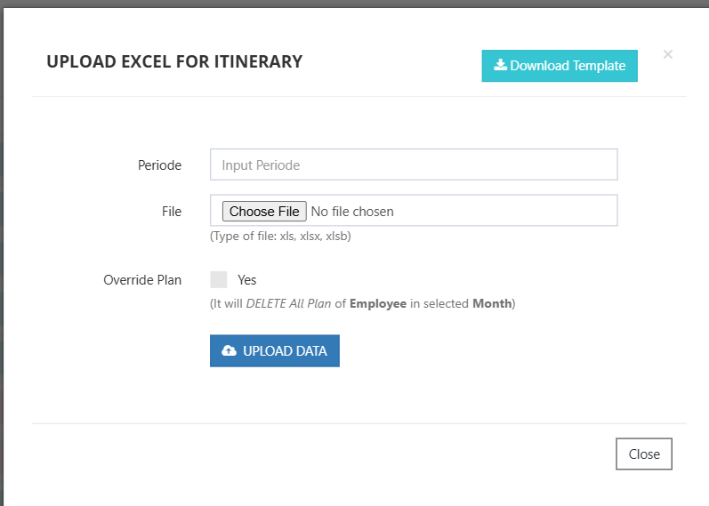
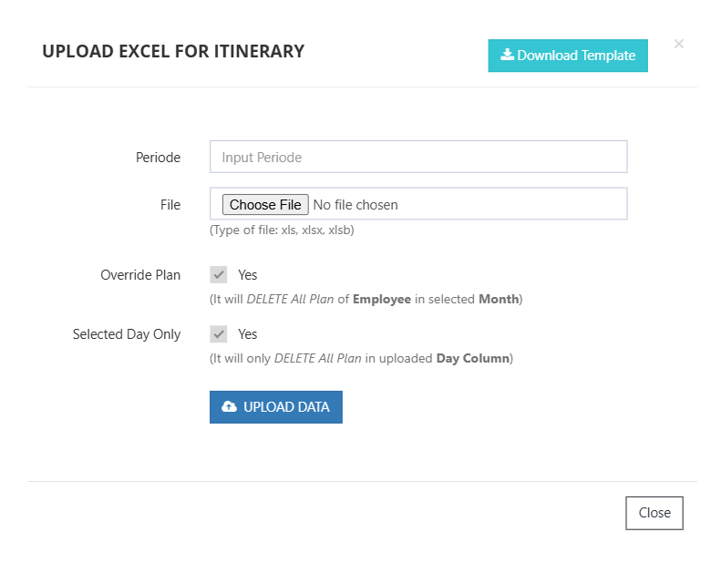
PT Anugrah Terpercaya Kerja
Attendance - PJP
Effective workforce solutions begin with trained, resilient, and reliable people.
anugrahterpercayakerja.co.id

Slide 10
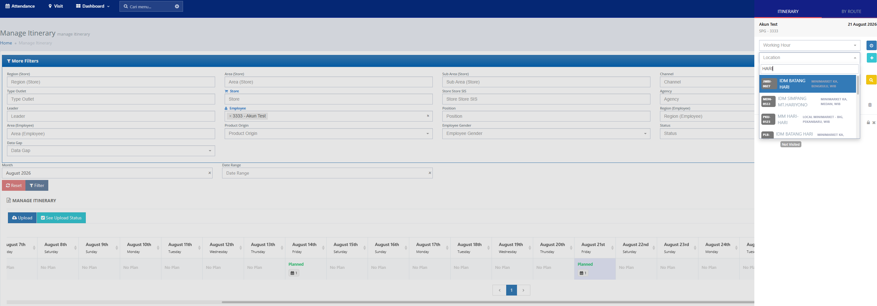
Attendance - PJP
PT Anugrah Terpercaya Kerja
Effective workforce solutions begin with trained, resilient, and reliable people.
anugrahterpercayakerja.co.id

Slide 11
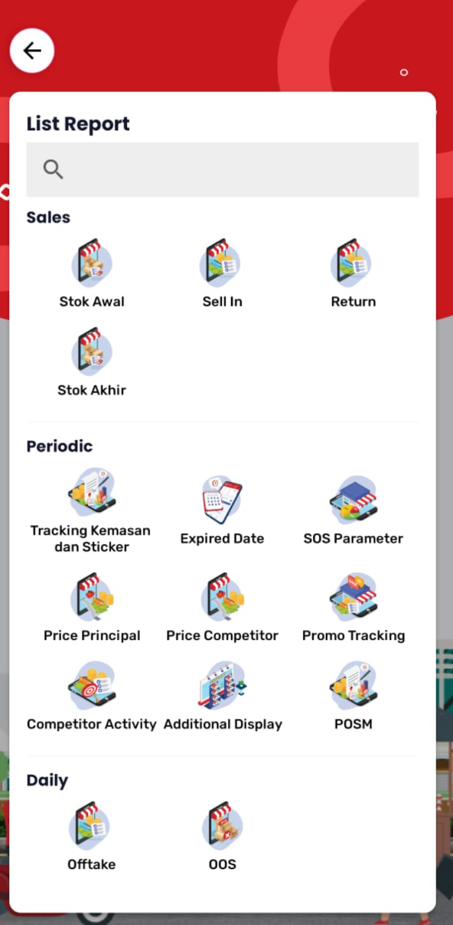
APPS
PT Anugrah Terpercaya Kerja
Effective workforce solutions begin with trained, resilient, and reliable people.
anugrahterpercayakerja.co.id

Slide 12
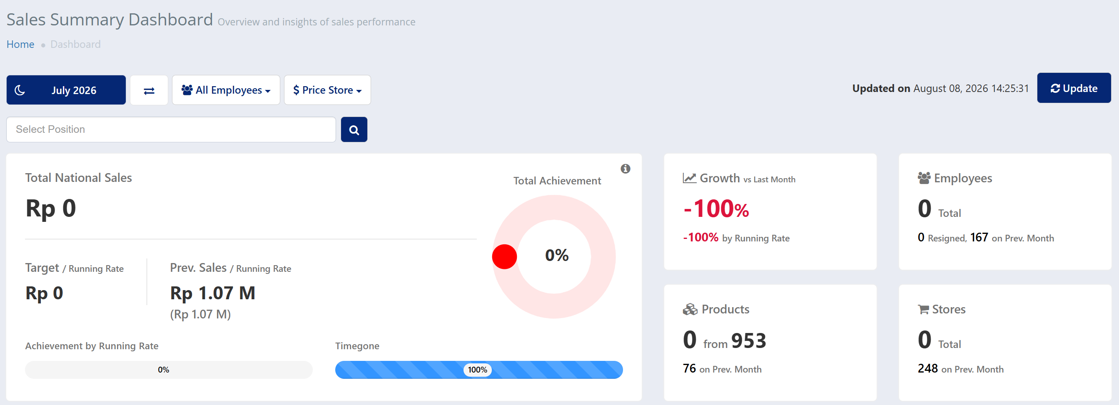
Dashboard Offtake SPG
PT Anugrah Terpercaya Kerja
Effective workforce solutions begin with trained, resilient, and reliable people.
anugrahterpercayakerja.co.id

Slide 13
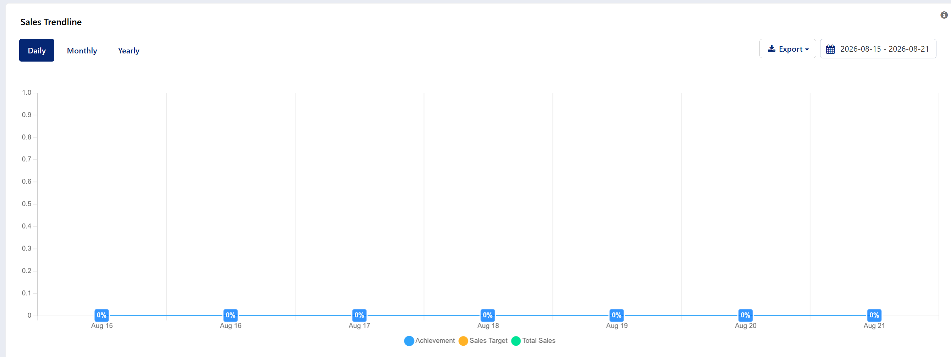
Dashboard Offtake SPG
PT Anugrah Terpercaya Kerja
Effective workforce solutions begin with trained, resilient, and reliable people.
anugrahterpercayakerja.co.id

Slide 14
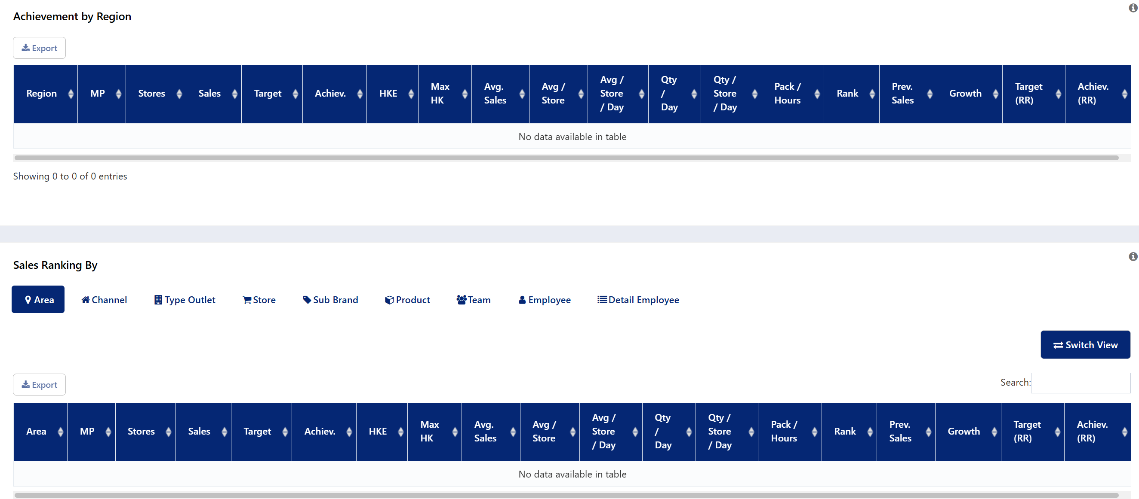
Dashboard Offtake SPG
PT Anugrah Terpercaya Kerja
Effective workforce solutions begin with trained, resilient, and reliable people.
anugrahterpercayakerja.co.id

Slide 15
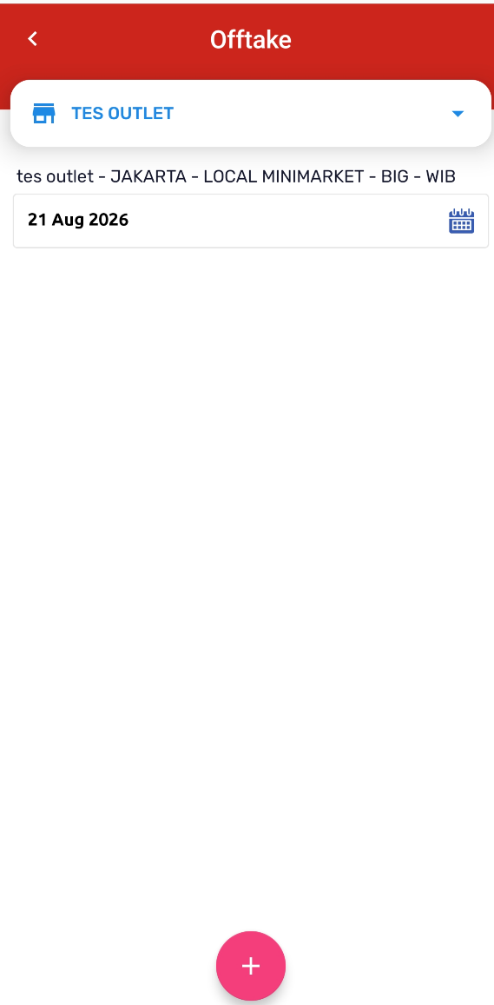
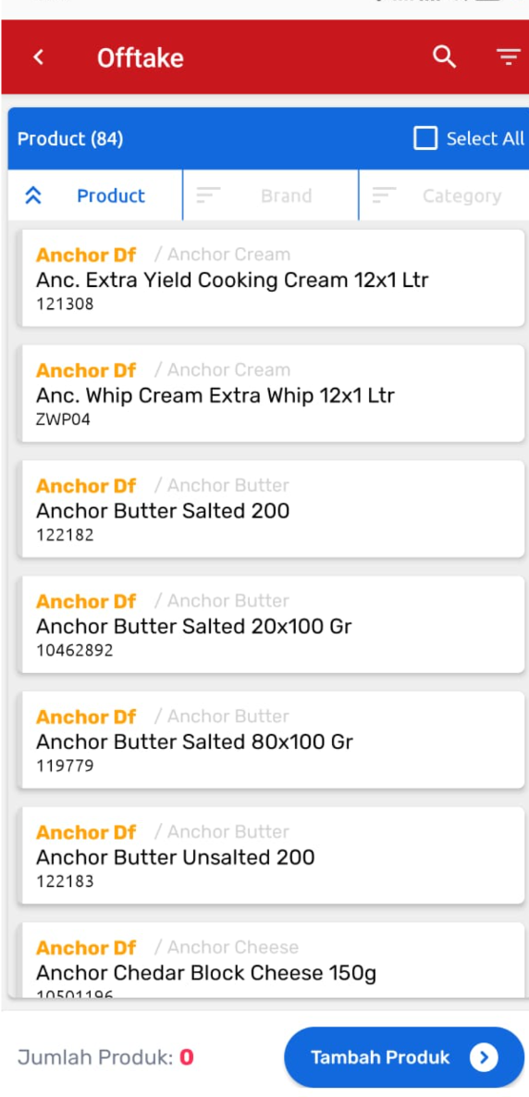
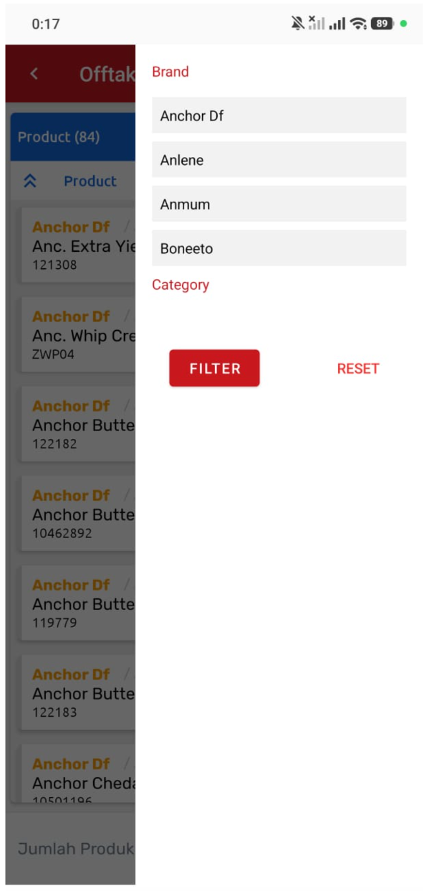
APPS – Offtake SPG
PT Anugrah Terpercaya Kerja
Effective workforce solutions begin with trained, resilient, and reliable people.
anugrahterpercayakerja.co.id

Slide 16
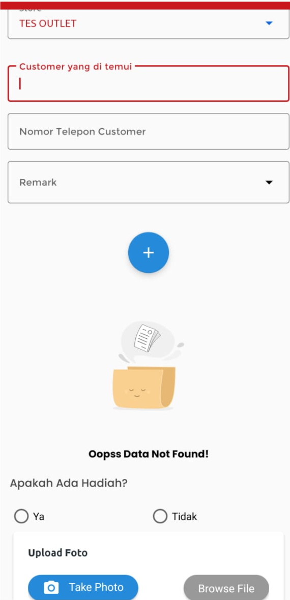
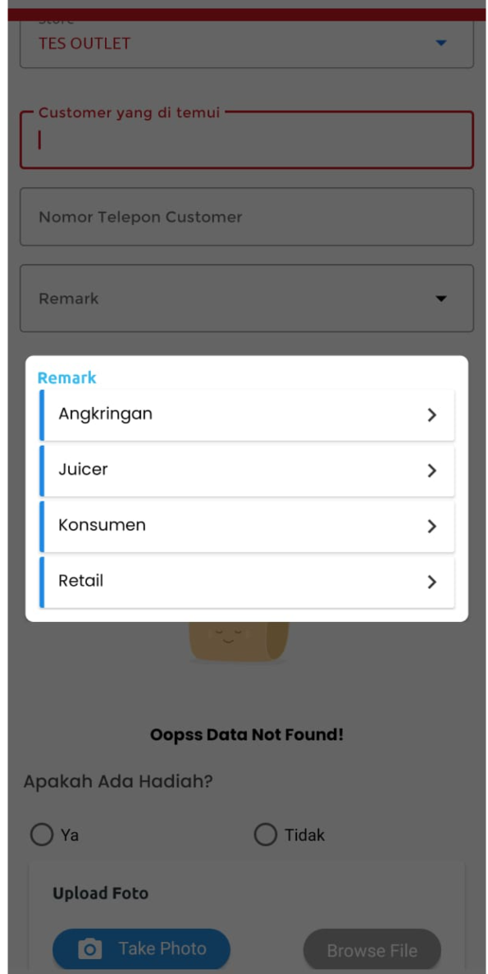
APPS – Offtake SPT
PT Anugrah Terpercaya Kerja
Effective workforce solutions begin with trained, resilient, and reliable people.
anugrahterpercayakerja.co.id

Slide 17
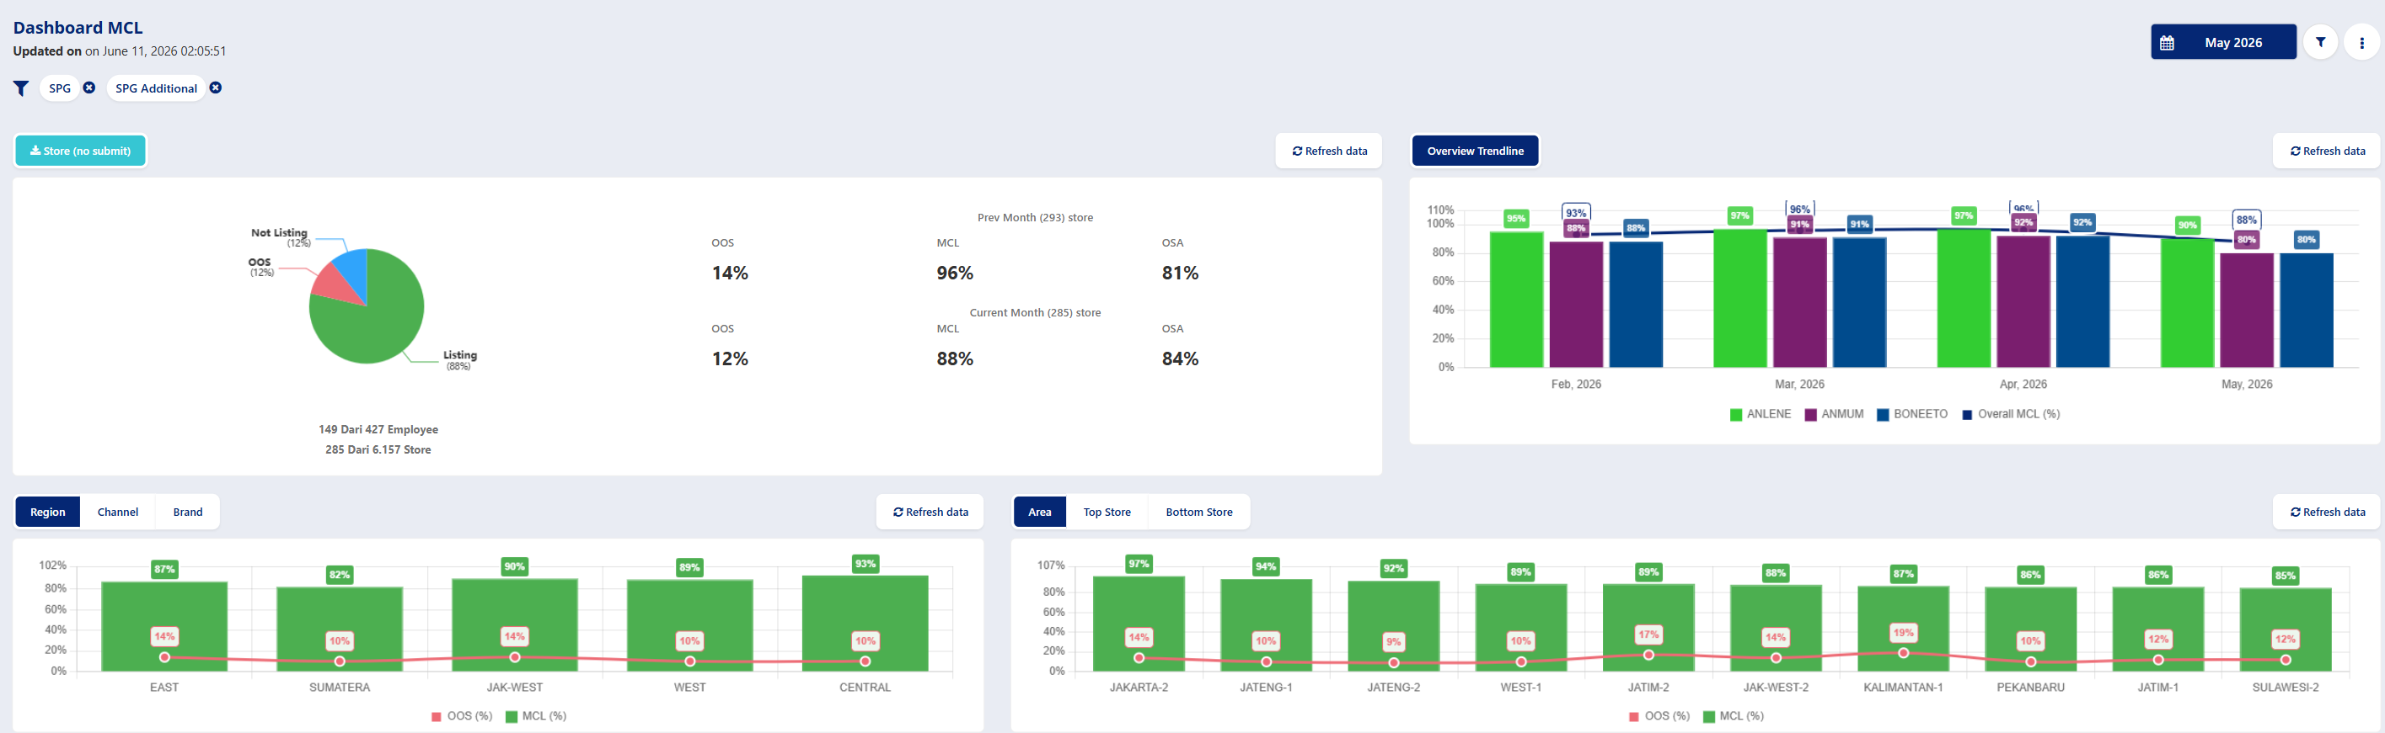
Dashboard MCL/Stock
PT Anugrah Terpercaya Kerja
Effective workforce solutions begin with trained, resilient, and reliable people.
anugrahterpercayakerja.co.id

Slide 18
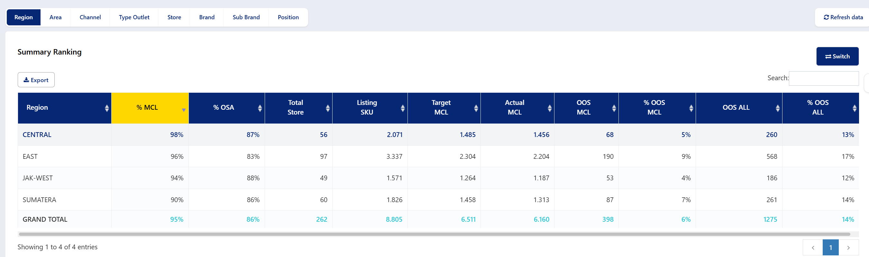
Dashboard MCL/Stock
PT Anugrah Terpercaya Kerja
Effective workforce solutions begin with trained, resilient, and reliable people.
anugrahterpercayakerja.co.id

Slide 19
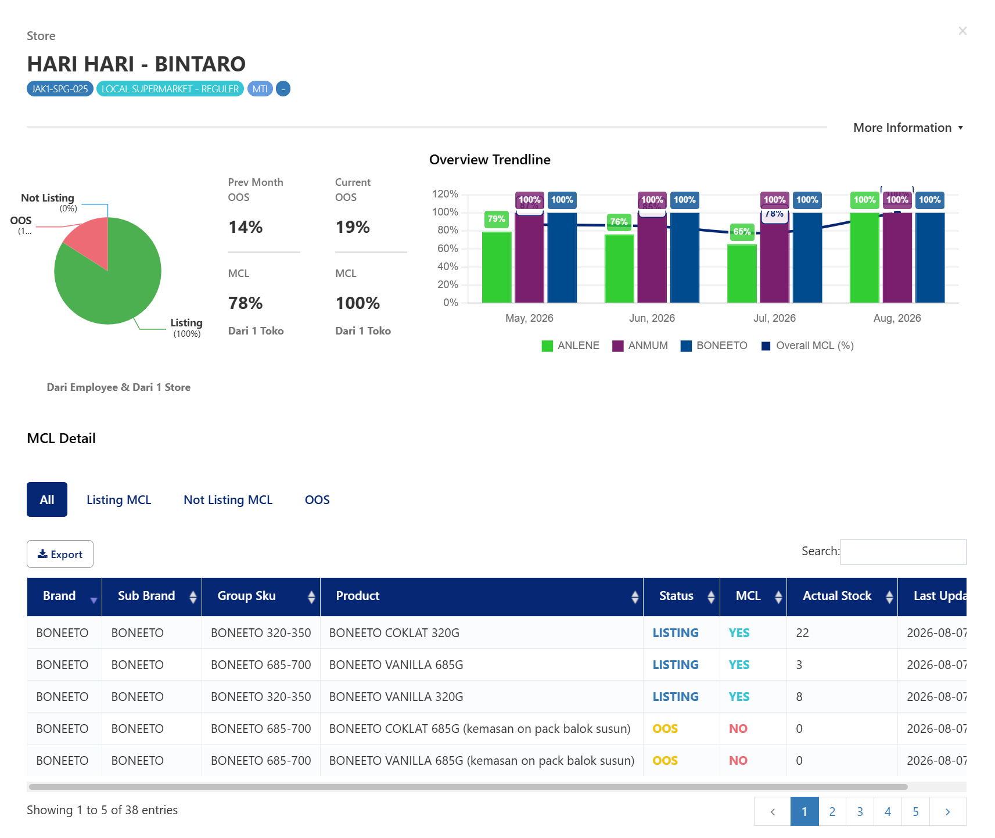
Dashboard MCL/Stock
PT Anugrah Terpercaya Kerja
Effective workforce solutions begin with trained, resilient, and reliable people.
anugrahterpercayakerja.co.id

Slide 20
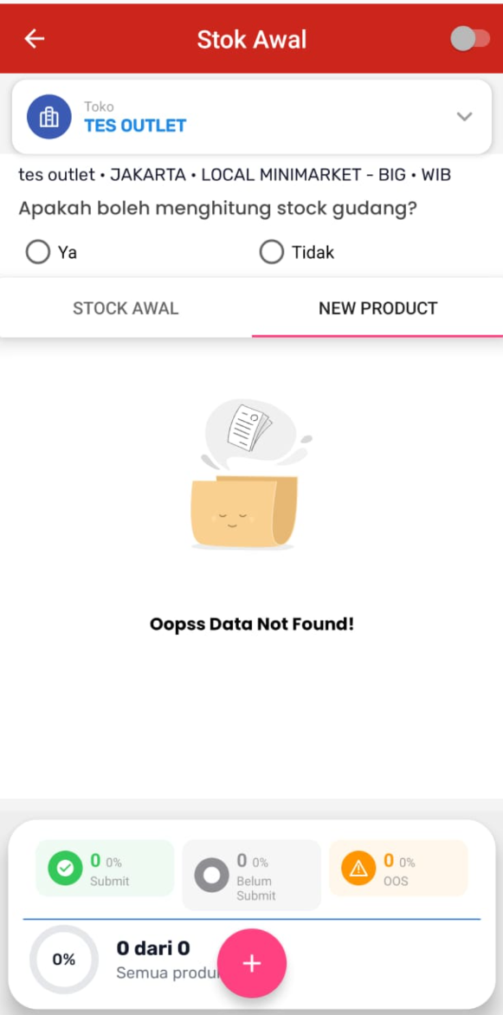
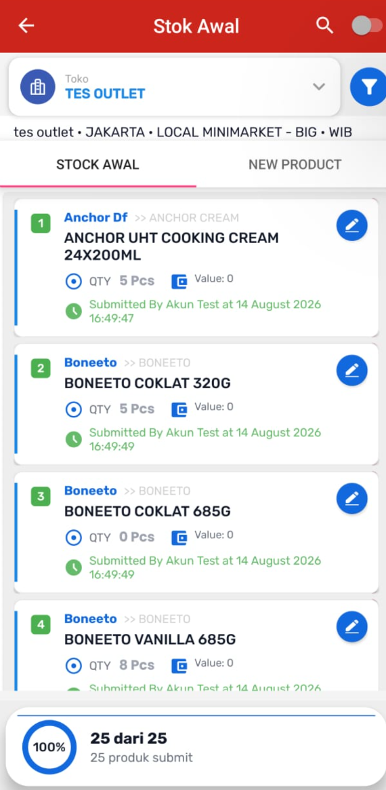
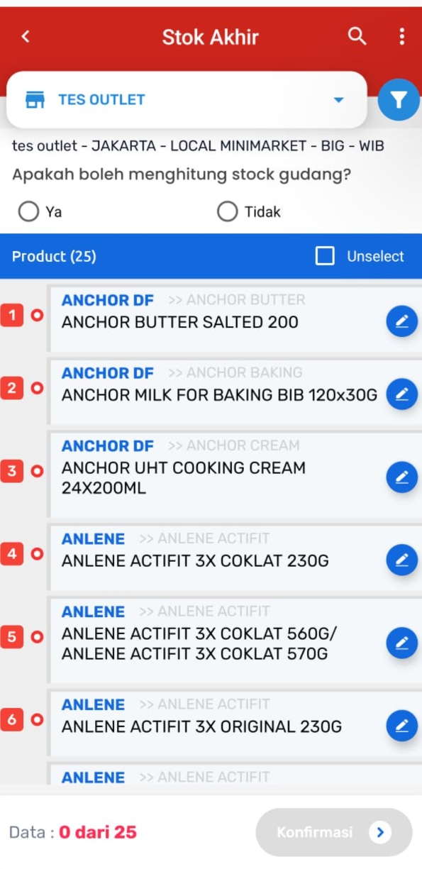
APPS - Stock
PT Anugrah Terpercaya Kerja
Effective workforce solutions begin with trained, resilient, and reliable people.
anugrahterpercayakerja.co.id

Slide 21
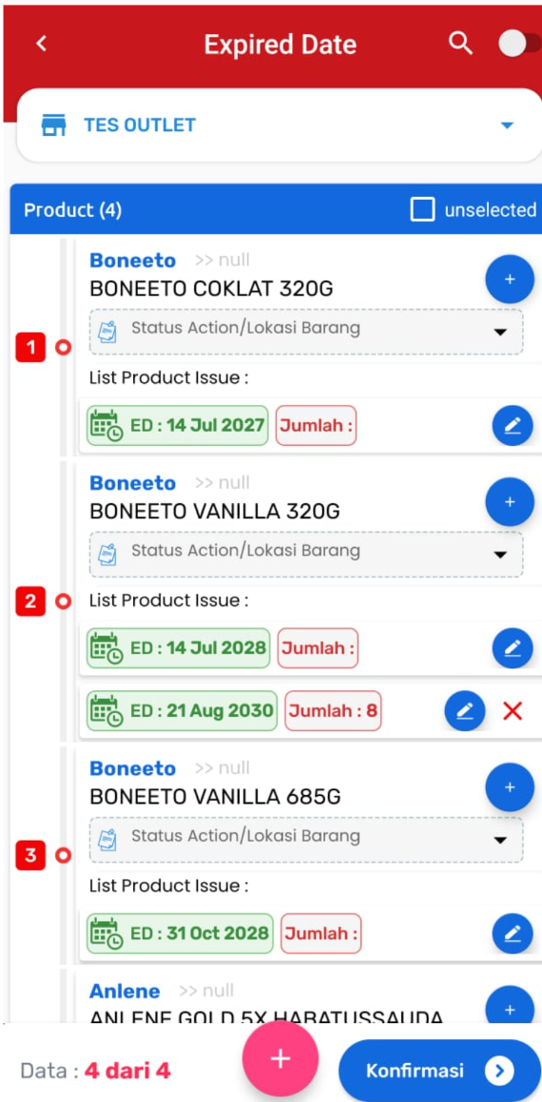
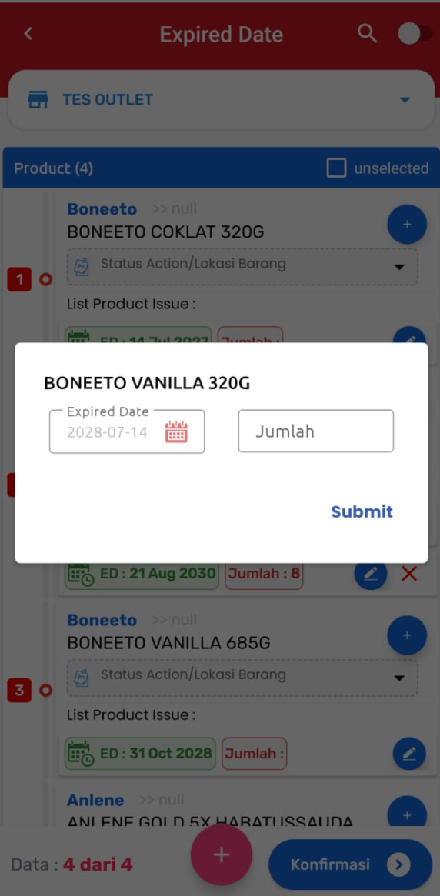
APPS – Expired Date
PT Anugrah Terpercaya Kerja
Effective workforce solutions begin with trained, resilient, and reliable people.
anugrahterpercayakerja.co.id

Slide 22
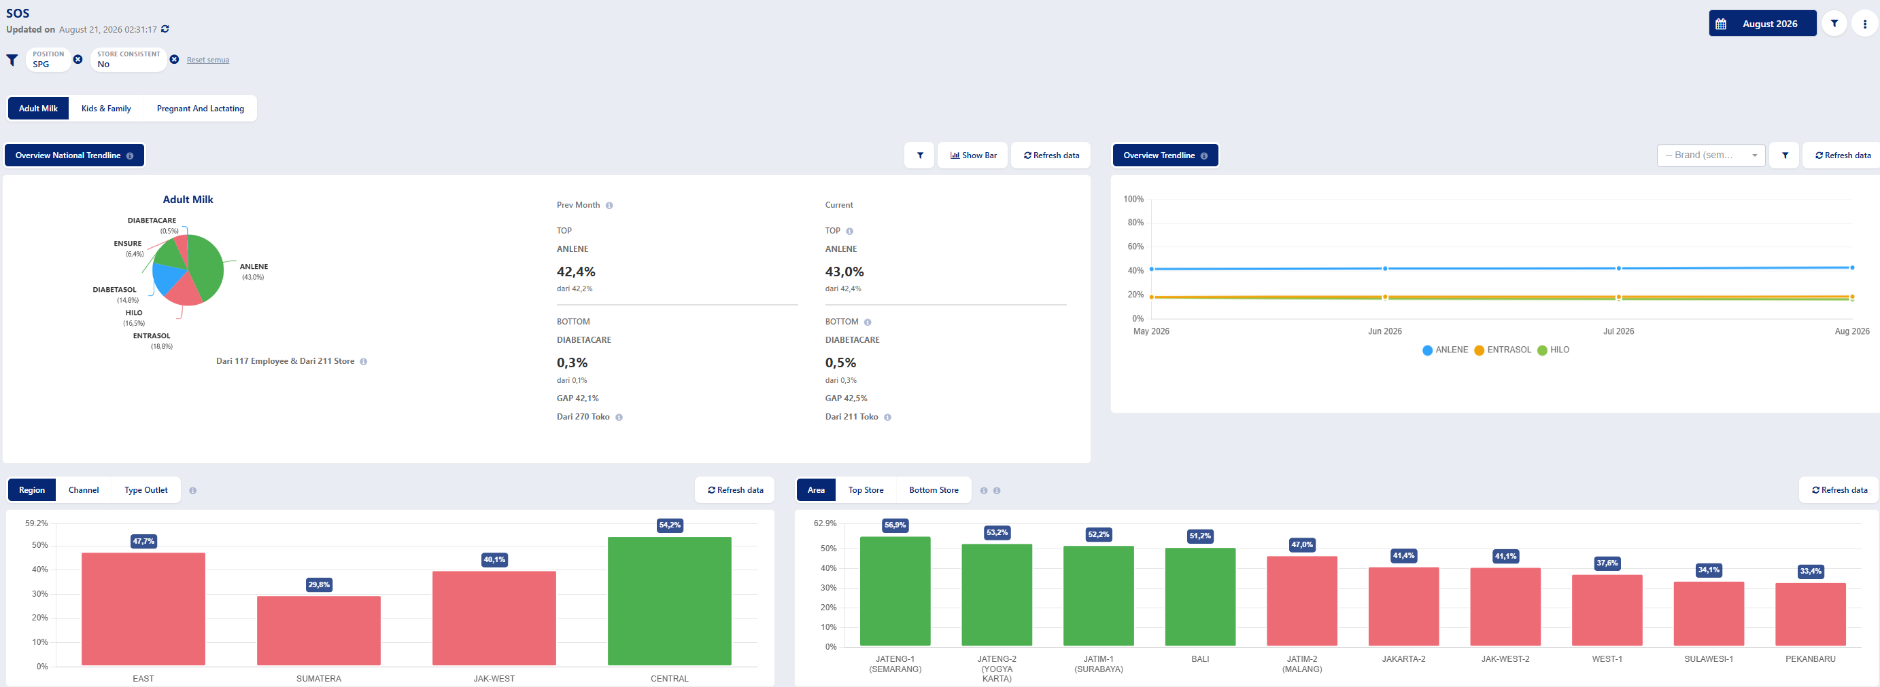
Dashboard SOS
PT Anugrah Terpercaya Kerja
Effective workforce solutions begin with trained, resilient, and reliable people.
anugrahterpercayakerja.co.id

Slide 23
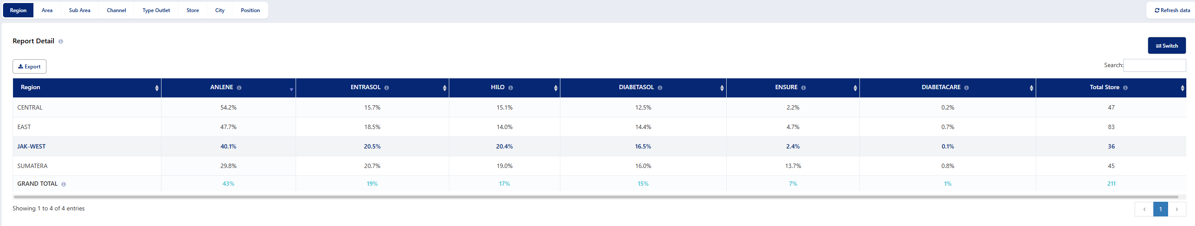
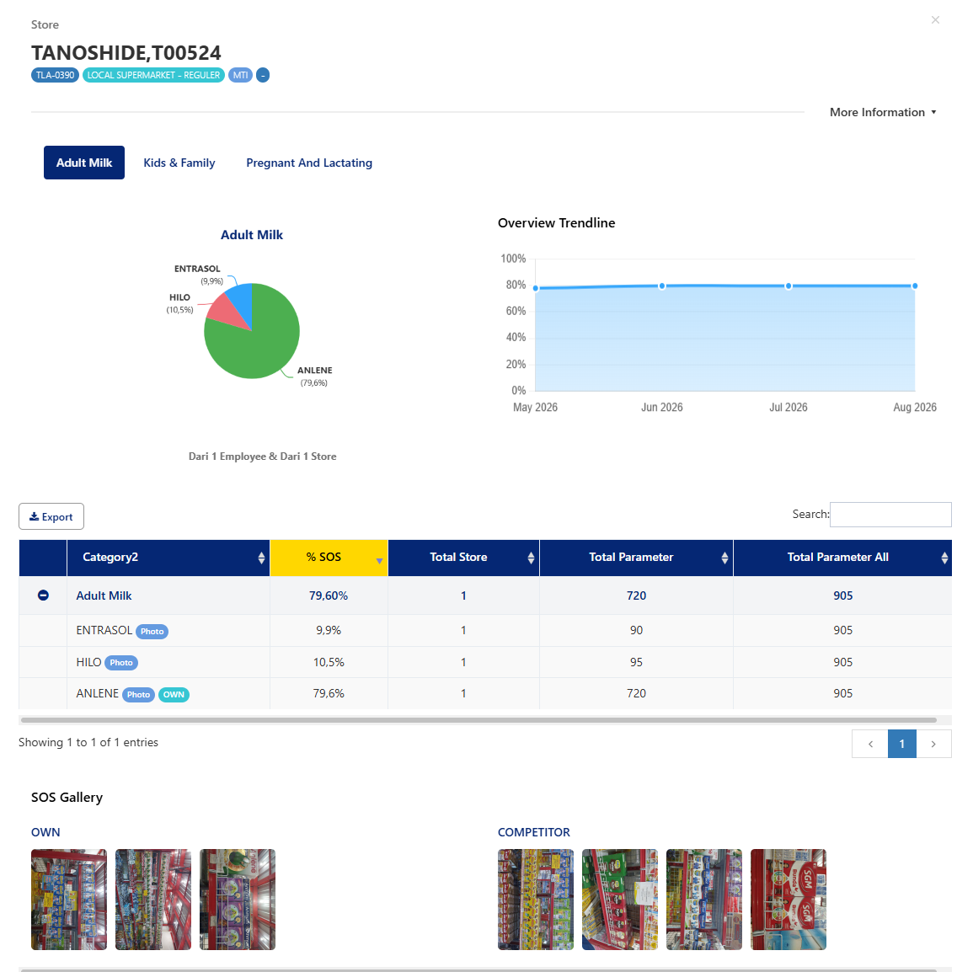
Dashboard SOS
PT Anugrah Terpercaya Kerja
Effective workforce solutions begin with trained, resilient, and reliable people.
anugrahterpercayakerja.co.id

Slide 24
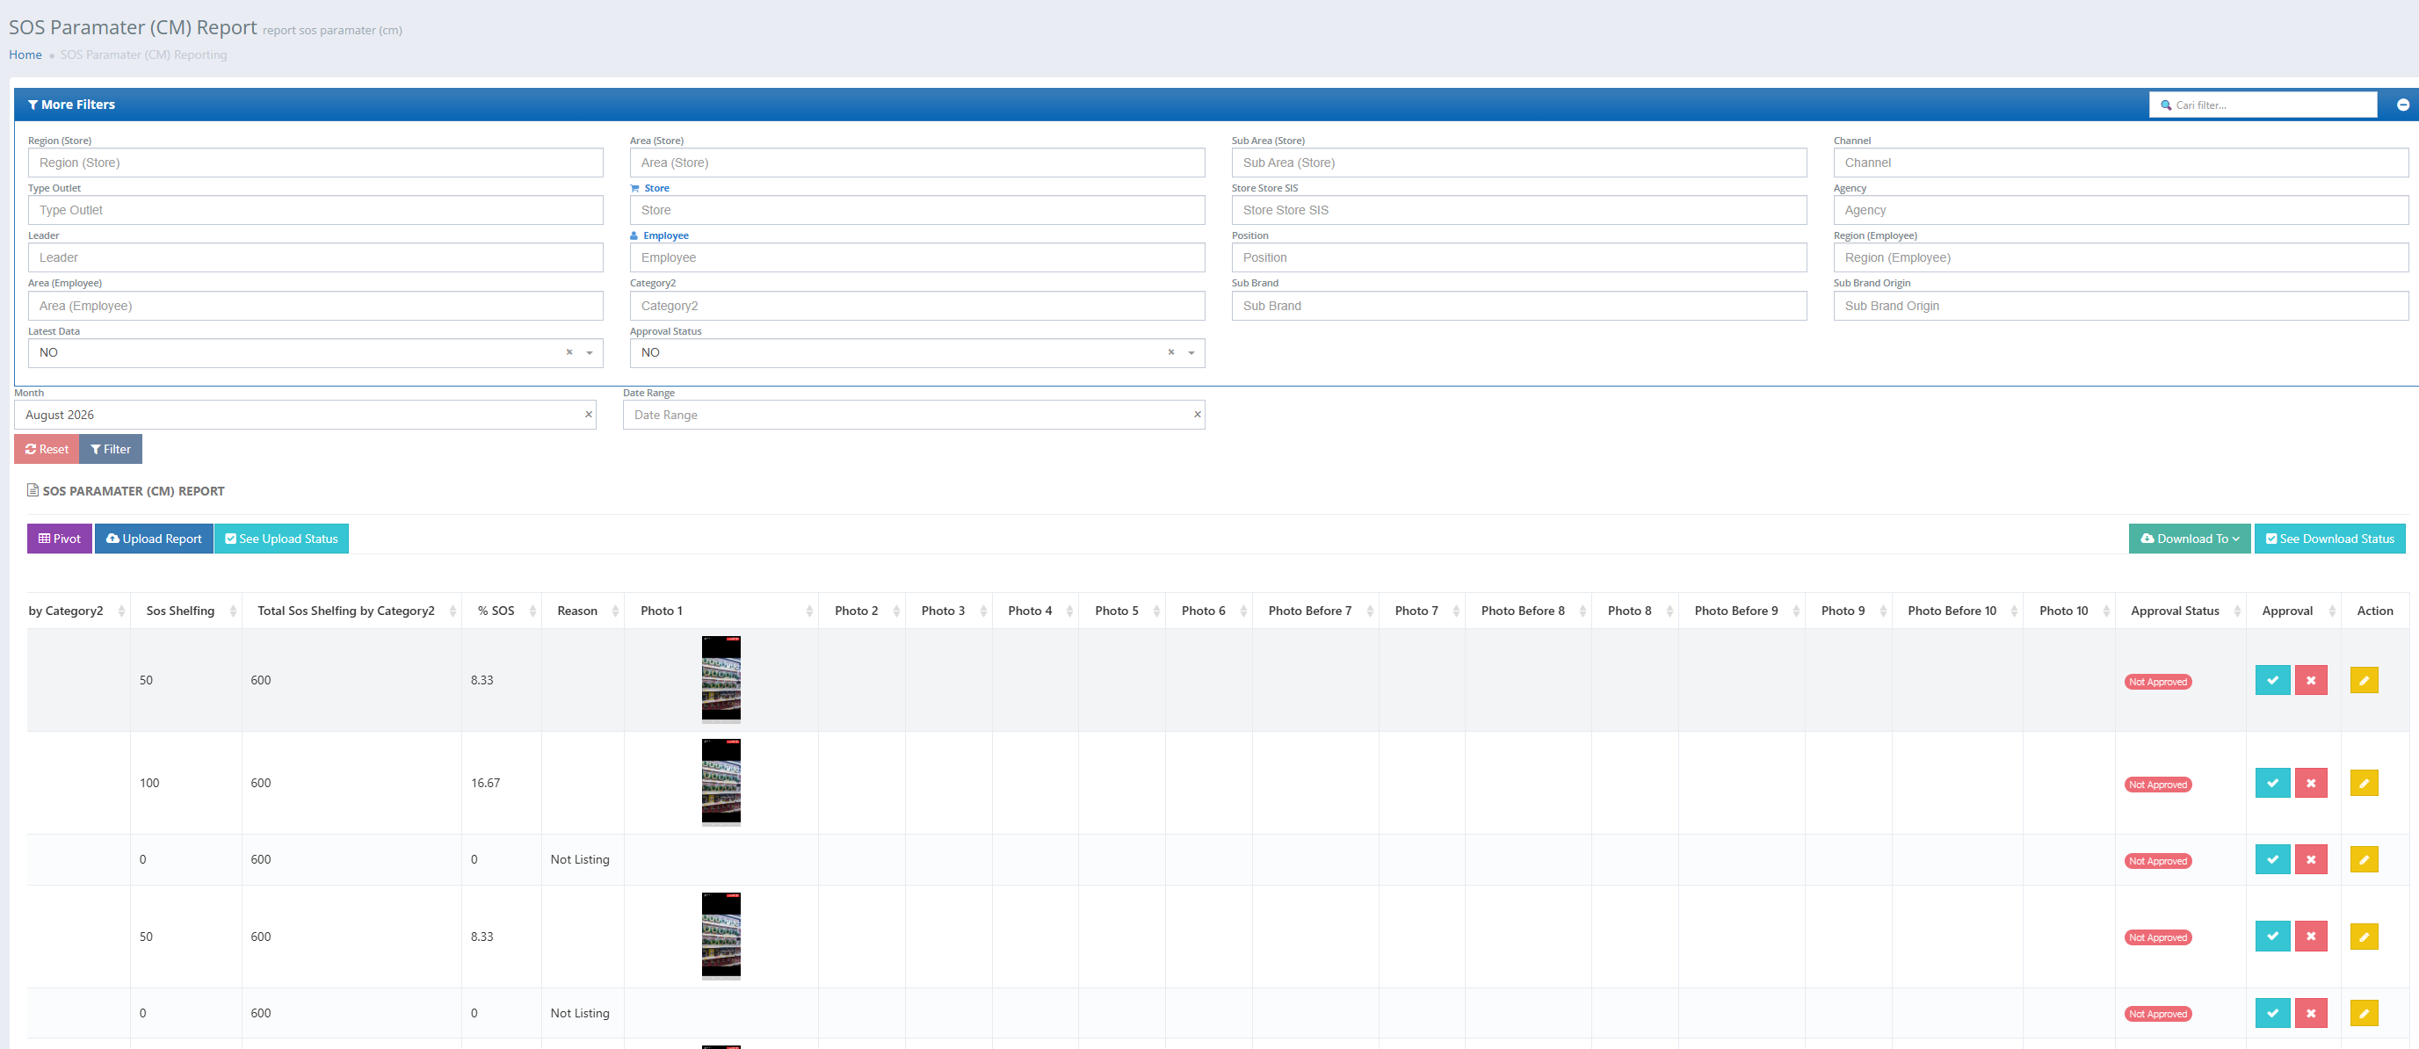
Dashboard SOS - Approval
PT Anugrah Terpercaya Kerja
Effective workforce solutions begin with trained, resilient, and reliable people.
anugrahterpercayakerja.co.id

Slide 25
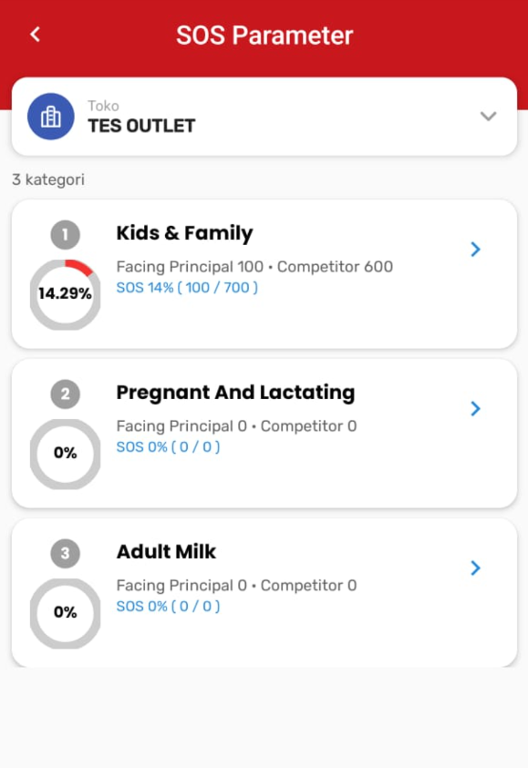
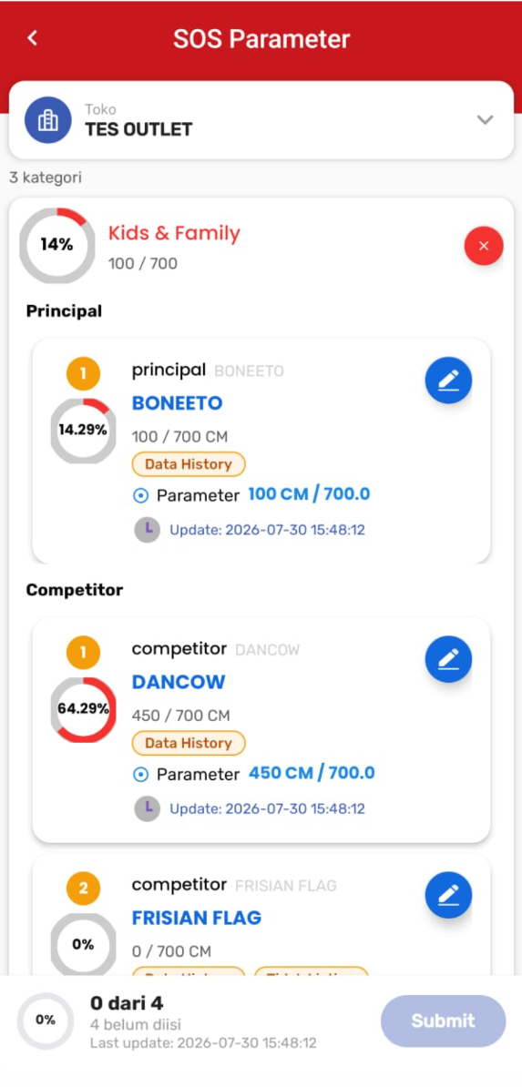
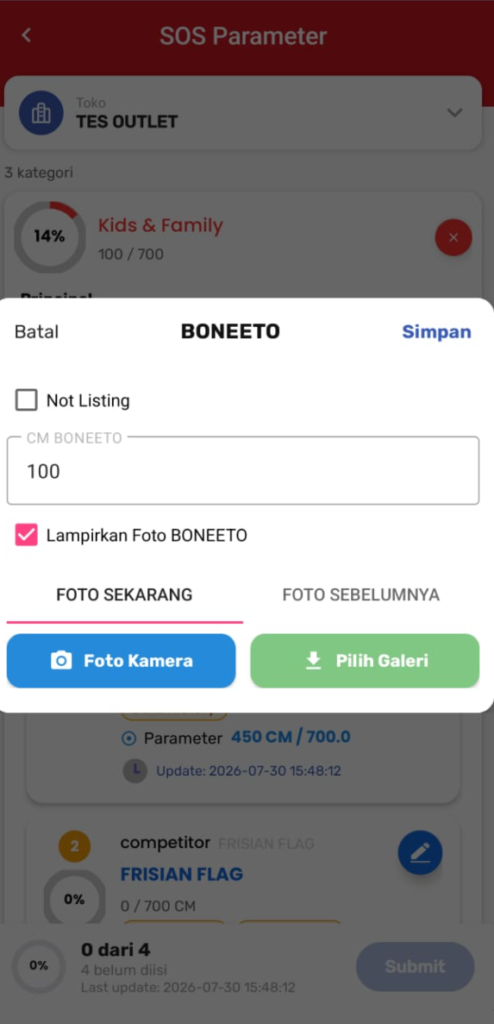
APPS - SOS
PT Anugrah Terpercaya Kerja
Effective workforce solutions begin with trained, resilient, and reliable people.
anugrahterpercayakerja.co.id

Slide 26
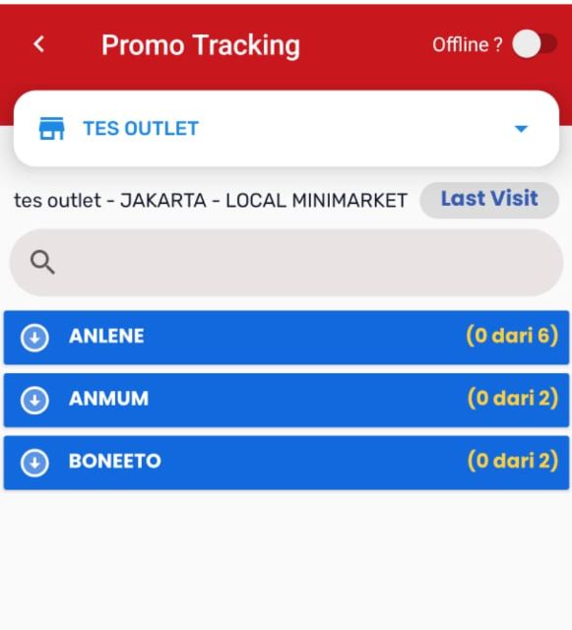
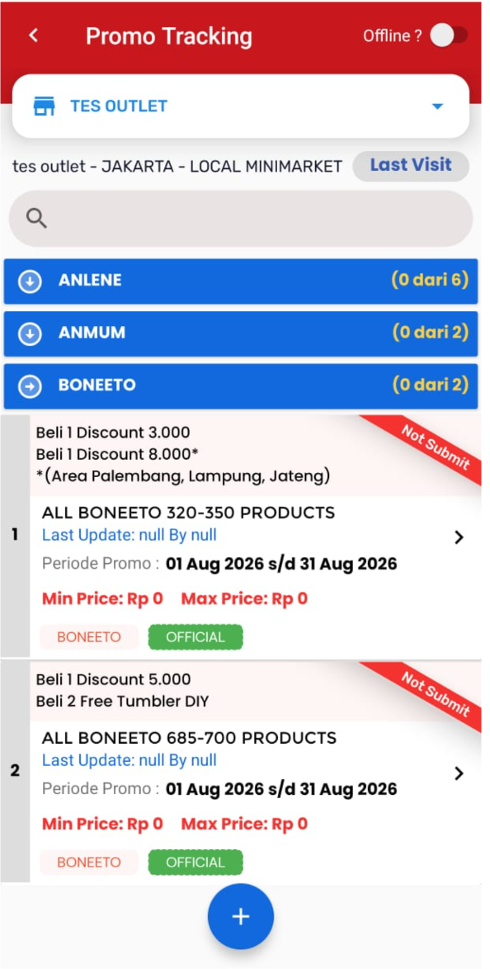
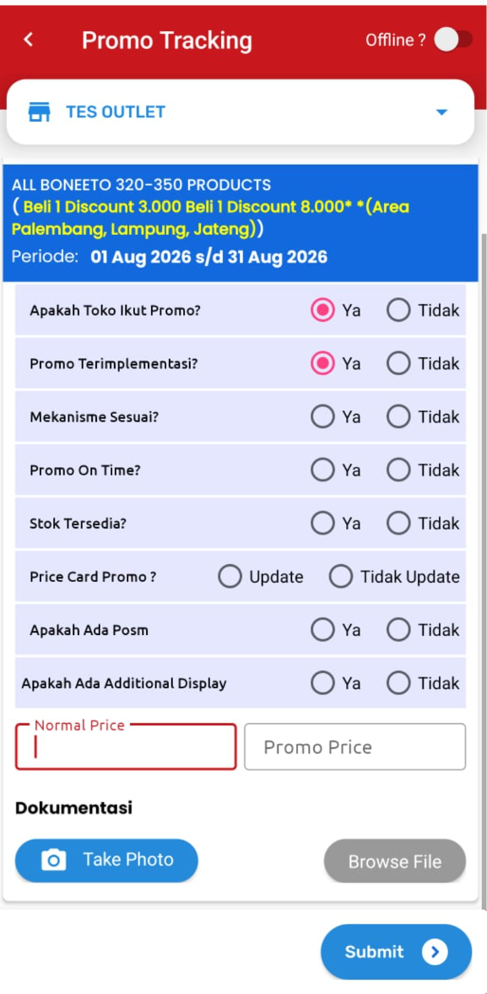
APPS – Price Own & Competitor
PT Anugrah Terpercaya Kerja
Effective workforce solutions begin with trained, resilient, and reliable people.
anugrahterpercayakerja.co.id

Slide 27
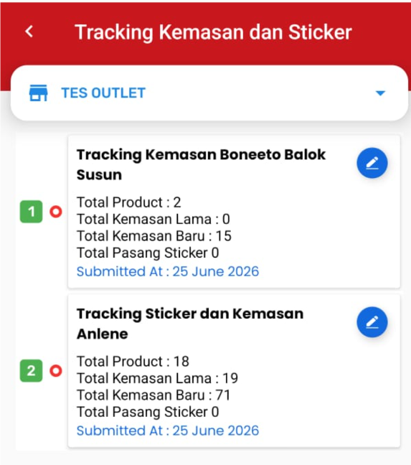
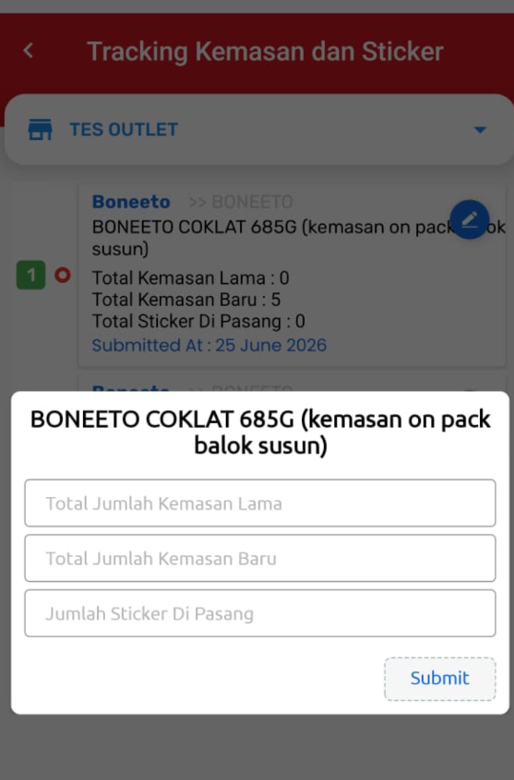
APPS - Kemasan & Sticker
PT Anugrah Terpercaya Kerja
Effective workforce solutions begin with trained, resilient, and reliable people.
anugrahterpercayakerja.co.id

Slide 28
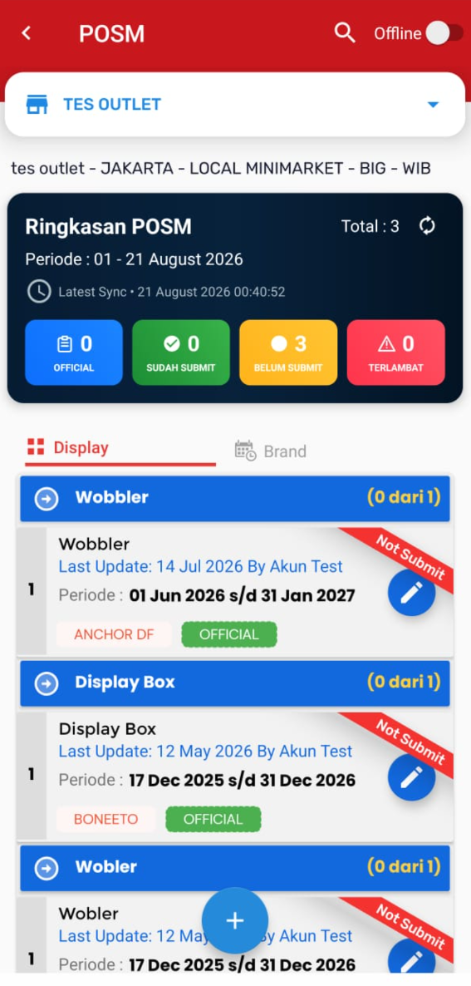
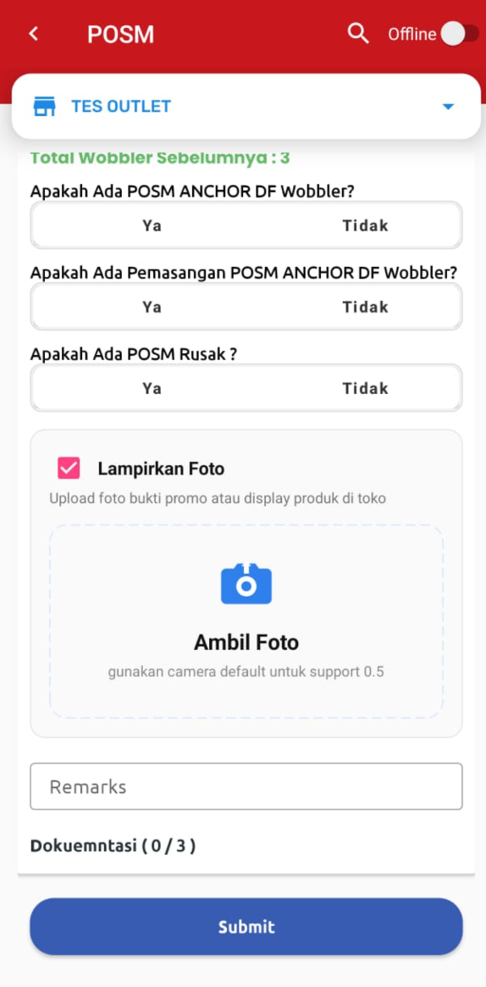
APPS - POSM
PT Anugrah Terpercaya Kerja
Effective workforce solutions begin with trained, resilient, and reliable people.
anugrahterpercayakerja.co.id

Slide 29
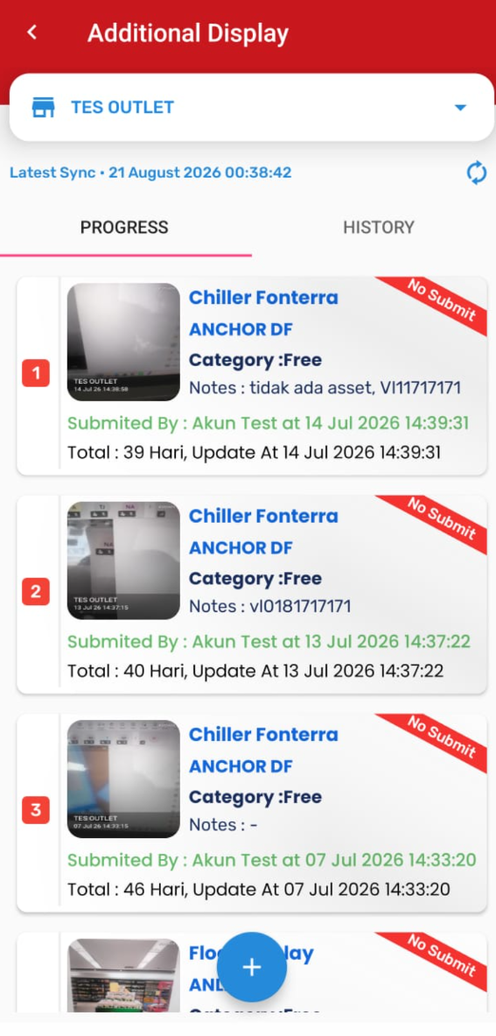
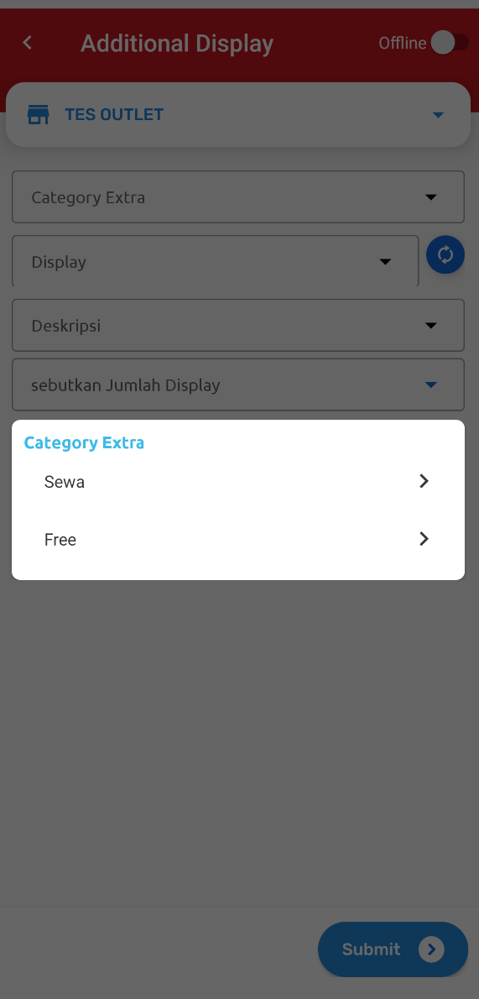
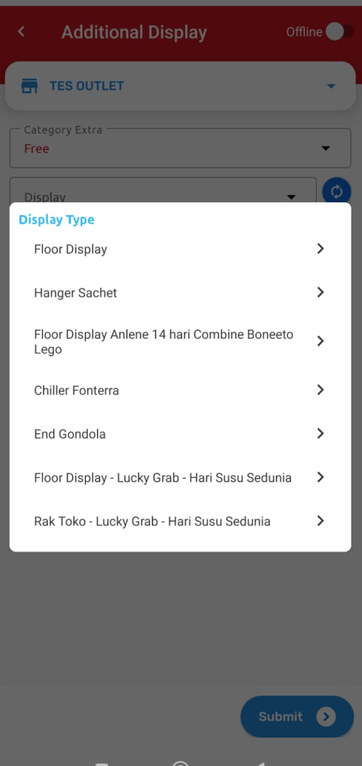
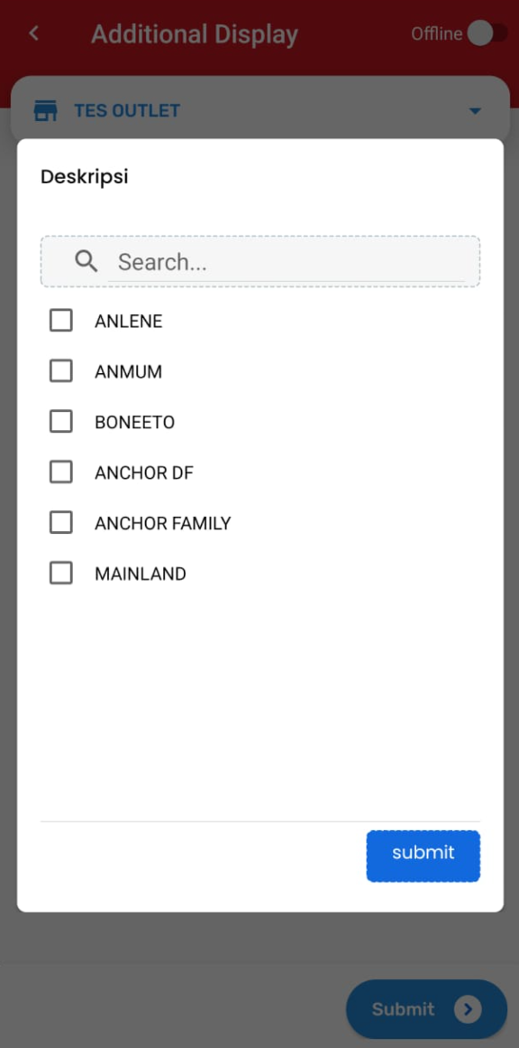
APPS – Additional Display
PT Anugrah Terpercaya Kerja
Effective workforce solutions begin with trained, resilient, and reliable people.
anugrahterpercayakerja.co.id

